Slide 1
More Than Before
Don Wetherhold
President
Contract Sales & Services
Notes:
Copyright 2002 Cardinal Health Inc All Rights Reserved
Cardinal Health Overview PResentation V3.9 April 2002
NOTES
For questions on Cardinal Health, please email pts@cardinal.com, or visit www.cardinal.com/pts
Cardinal Health Employees: for questions on or suggestions regarding this presentation, please email Cornell Stamoran (cornell.stamoran@cardinal.com) or Pat McGee (patricia.mcgee@cardinal.com)
Version 3.9, 1 April 2002

Slide 2


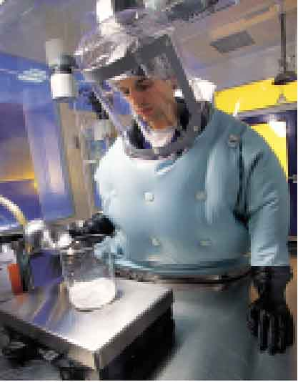
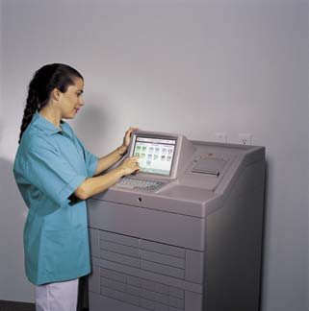
Cardinal Health Operating Groups
Pharmaceutical Distribution & Provider Services
Medical-Surgical
Products & Services
  Drug distribution & logistics
  Blood products
  Radio-pharmaceuticals
  Formulary consulting
  Pharmacy management
  Franchised retail stores
Manufacturing
Distribution
Provider consulting
Medicine safety consulting
Automation & Information Services
Pharmaceutical
Technologies & Services
Drug development services
Drug delivery systems
Manufacturing and packaging
Product launch acceleration
Product life cycle extension
  Automated dispensing
  Clinical and market information
Notes:
Copyright 2002 Cardinal Health Inc All Rights Reserved
Cardinal Health Overview PResentation V3.9 April 2002
We will talk about all of Cardinal’s offerings to pharmaceutical and biotechnology manufacturers from any of these segments, most of which are concentrated in the Pharmaceutical Technologies & Services segment.
Within the Distribution and Provider Services segment, however, there is a significant degree of expertise in the logistics for and distribution of pharmaceutical products in the United States. Also, there is a significant understanding of prescribing and buying behavior in retail pharmacy and hospital pharmacy channels.
Within the med-surg segment, there is a significant infrastructure around the production and distribution of medical devices and surgical supplies. Cardinal has extensive interactions with hospital systems in the US.
Finally, within the Automation and Information services segment, falls the “RealTime” business, which is a joint venture with Cardinal and other key pharmacy data providers - including WalMart and Kmart. This system can provide daily - even hourly - updates as to prescription filled data, extending up to “DDD”/doctor level data.

Slide 3
Pharmaceutical Technologies & Services
Seven decades of outsourcing experience
More than 10,000 people on five continents
Over 1,000 patents and applications
Our mission:
Provide integrated, enabling technologies and services that bring quality products to market faster and deliver greater value
Notes:
Copyright 2002 Cardinal Health Inc All Rights Reserved
Cardinal Health Overview PResentation V3.9 April 2002
Cardinal Health Pharmaceutical Technologies & Services is:
- The world’s largest drug delivery technology company
- The world’s largest independent pharmaceutical packaging company
- The world’s largest (non-CRO) pharmaceutical outsourcing company
- Nearly half a billion doses are developed, manufactured or packaged every day in our facilities
This slide focuses on:
Experience (7 decades)
Global expertise and depth of talent (people/continents)
Innovation (1000+ patent and patent applications)

Slide 4
Our Range of Offerings
Discovery & Development
Drug Delivery
Mfg. & Packaging
Sales
&
Marketing
Distribution
Pharmaceutical Technologies & Services
Cardinal Health
Notes:
Copyright 2002 Cardinal Health Inc All Rights Reserved
Cardinal Health Overview PResentation V3.9 April 2002

Slide 5
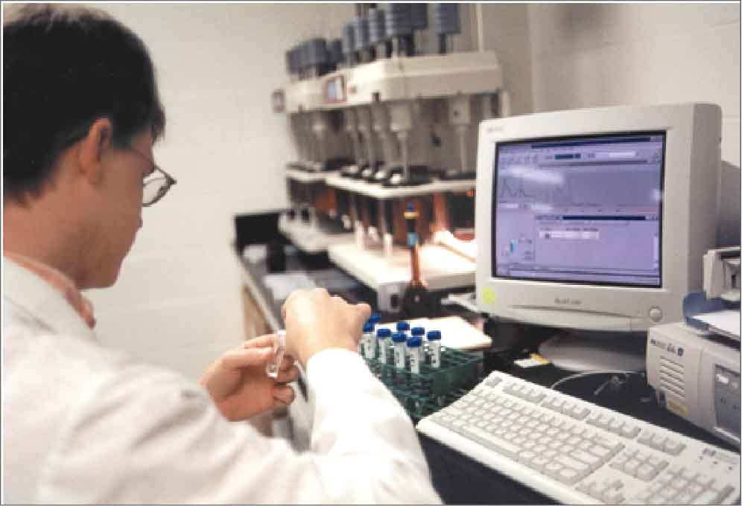
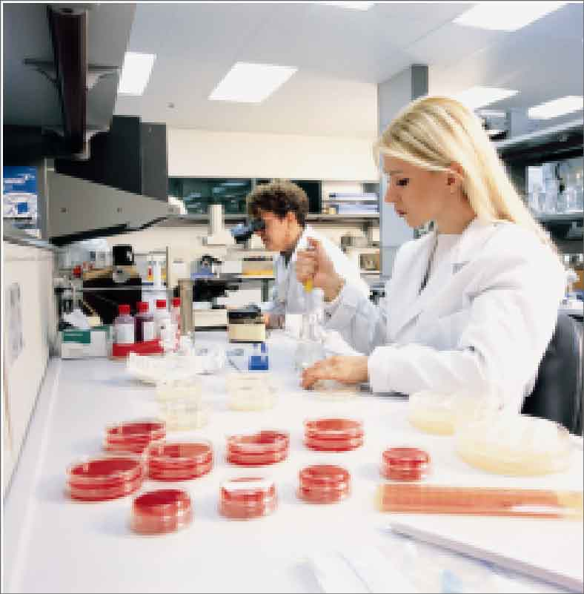
Drug Discovery & Development
Services Provided:
Analytical Testing
Bioanalysis
Biotechnology
Clinical Packaging
Compendial Analysis
Drug Discovery & Bioassays
Drug Substance Testing
Inhalation Product Development
Method Development & Validation
Notes:
Copyright 2002 Cardinal Health Inc All Rights Reserved
Cardinal Health Overview PResentation V3.9 April 2002
“new” reflect either completely new or significantly expanded capabilities arising from the Magellan acquisition
Many of these services are available both in the US and Europe...

Slide 6
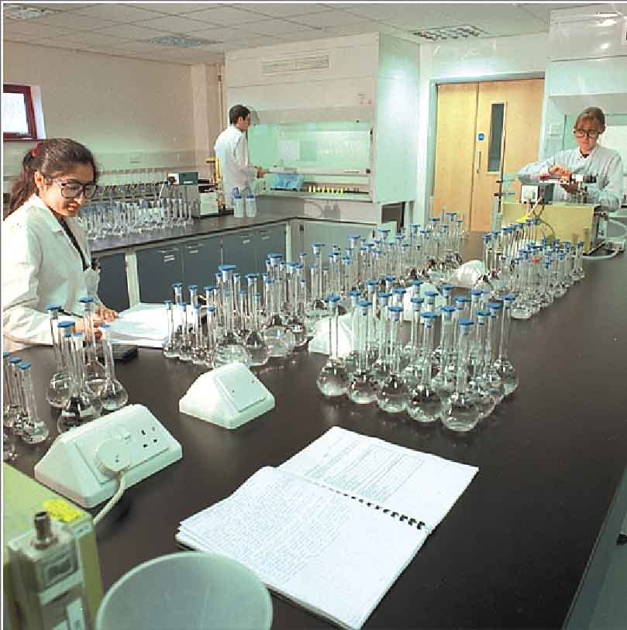
Drug Discovery & Development
Services Provided:
Microbiology
Pharmaceutical Synthesis
Pharmaceutical Validation Services
Pharmaceutics
Quality Assurance Consulting
Regulatory Affairs
Stability Storage
Stability Testing
Structural Chemistry
Notes:
Copyright 2002 Cardinal Health Inc All Rights Reserved
Cardinal Health Overview PResentation V3.9 April 2002
Complete clinical supplies management - producing the dose form, placebos, and blinded comparator drugs; custom-designed packaging to achieve clinical needs; and tracking, logistics, and warehousing of clinical supplies - based both in the US and Europe.

Slide 7
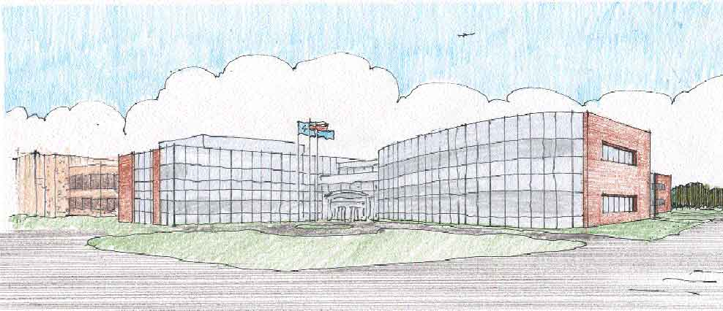
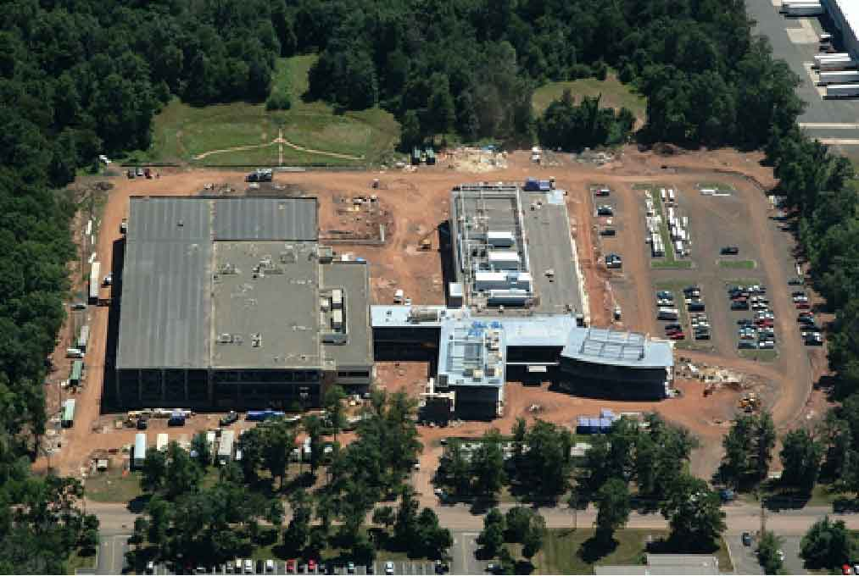

Drug Discovery & Development
Facilities
RTP, North Carolina
San Diego, California
Albuquerque, New Mexico
Somerset, New Jersey
1/10th scale pilot manufacturing
Notes:
Copyright 2002 Cardinal Health Inc All Rights Reserved
Cardinal Health Overview PResentation V3.9 April 2002
We are committed to understanding the present and future needs of our pharmaceutical and biotechnology customers, and to meeting those needs through investments in facilities, existing and new technologies, and in the expertise of our employees.
From listening to our customers, we understood that the development “crunch” facing pharmaceutical companies today makes it even more critical that the drug discovery and development process be as efficient and effective as possible. While we had existing capabilities to offer our customers in the development services area, we felt that we needed to offer a greater breadth of services, and greater available resources, to help our customers shorten the development process.
We looked at building the capabilities internally, or buying a existing leading provider of those services - and decided to do both. To buy a “gold standard” provider of development services to pharmaceutical and biotechnology firms, and to construct a facility in the Northeast US to expand their capacity AND offer dedicated capacity for pilot scale oral manufacturing and packaging up to 1/10 scale.
Magellan is the leading US provider of contract drug development services.
Magellan is Cardinal Health’s sixteenth pharmaceutical technologies & services acquisition since 1996.

Slide 8
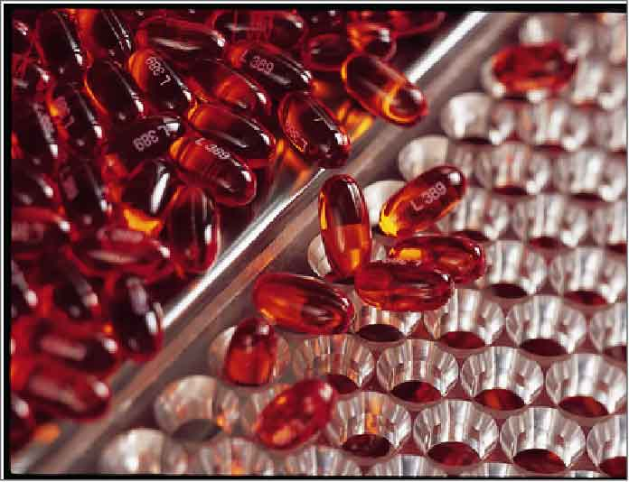
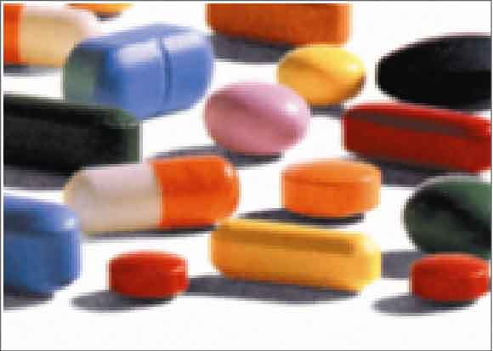
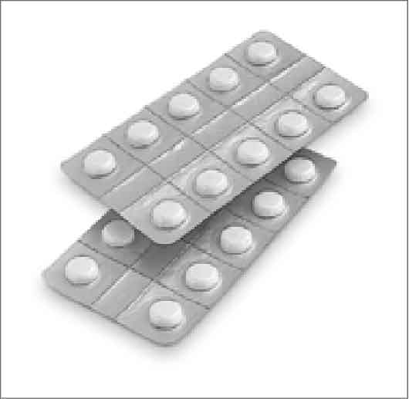
Drug Delivery
    Zydis® fast-dissolving dosage form
    Softgels (and R.P. Scherersol® formulations)
    Coating technologies for functional release, including Cleantaste® & Encirc®
    Topical Microsponge® and Polytrap® technologies
    Hardshell capsules
    Blow-fill-seal aseptic liquid packaging
    Proprietary sterile liposome systems
Notes:
Copyright 2002 Cardinal Health Inc All Rights Reserved
Cardinal Health Overview PResentation V3.9 April 2002
As the world’s leading drug delivery technology provider, we have advanced drug delivery systems for almost every route of administration - oral, topical, and parenteral.
We have a proven track record of helping our customers’ drugs improve therapeutically - with a faster onset of action, improved bioavailability, reduced side effect profile, or controlled time or place of release.
The proprietary delivery systems we offer can also bring marketing benefits - many of the technologies are consistently consumer preferred, which helps drive increased patent compliance. As many are patented, and/or can help lead to a specific formulation patent, the technologies can help you extend market exclusivity. And finally, in today’s highly competitive pharmaceutical market, they can also help differentiate your drugs.
Finally, several of the technologies are suitable for manufacturing highly potent drugs, even including cytotoxics. These technologies can make the manufacture, packaging and distribution of your drugs even safer and easier.

Slide 9
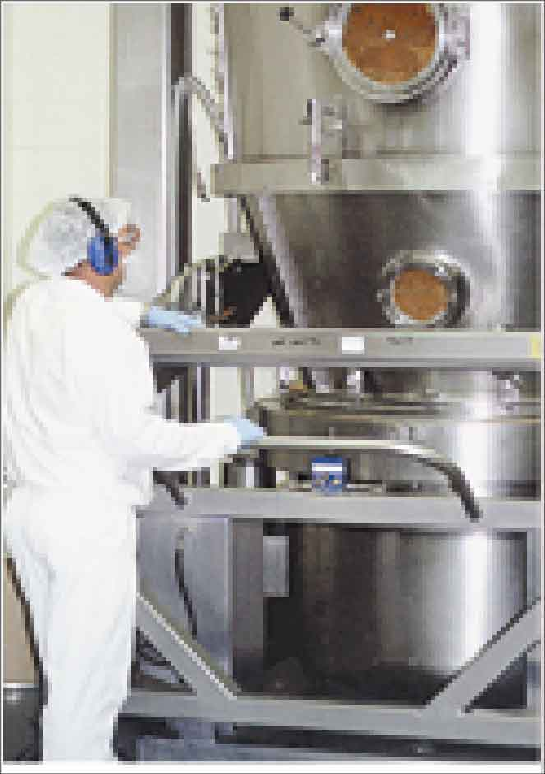
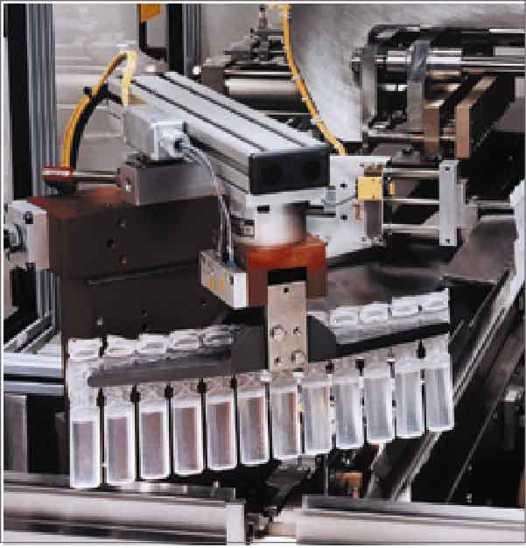
Manufacturing
    Oral dose forms
      All Cardinal Health drug
      delivery technologies
      Tablets (coated/uncoated)
      Hard capsules (filled)
      Granules for dispersion
    Blow/Fill/Seal technology
    Lyophilization/liposomes
    Sterile and Other forms
      Vials/ampoules
      Solutions/suspensions
      Ointments
      Pre-filled syringes
      Suppositories
Notes:
Copyright 2002 Cardinal Health Inc All Rights Reserved
Cardinal Health Overview PResentation V3.9 April 2002
In addition to all of the proprietary delivery technologies which we offer, we also manufacture a broad range of “traditional” and specialty oral and sterile/parenteral dose forms.
Our unique Blow-Fill-Seal sterile liquid manufacturing technology provides a single step process for sterile packaging.
Our experienced, validated lyophilization capabilities and significant expertise is in significant demand.

Slide 10
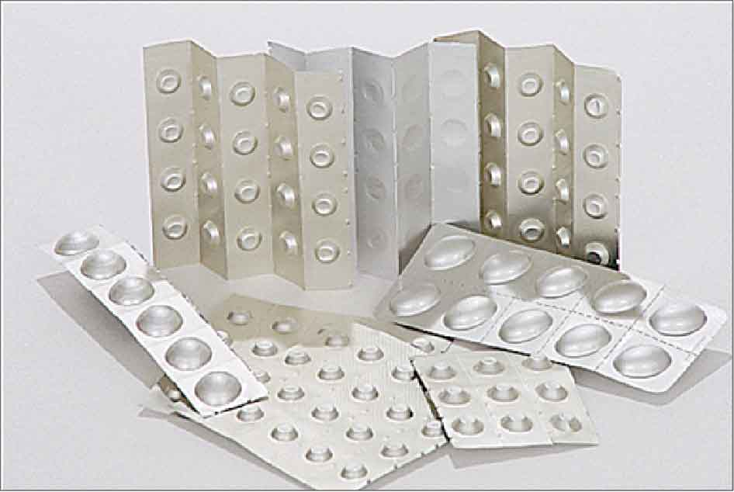
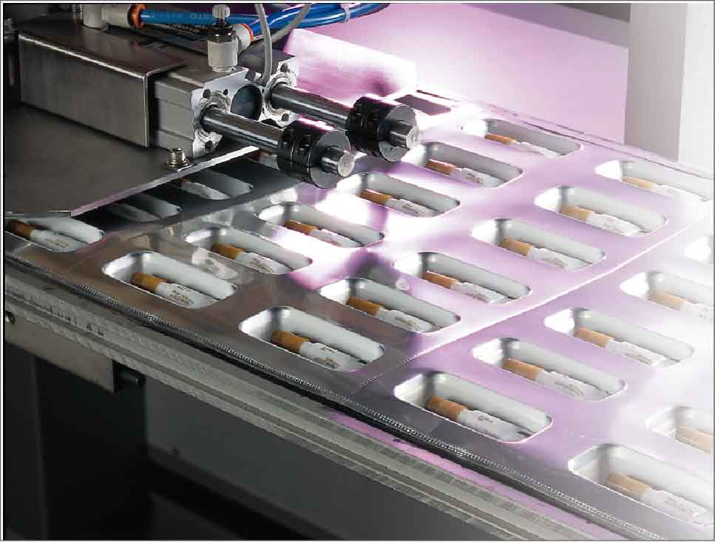
Packaging
Contract services
  Blister packing
  Pouch/strip packing
  Tray packing
  Bottle filling
  Design/tooling
Printed components
  Cartons, inserts, labels
  Promotional materials
Specialty packaging
Notes:
Copyright 2002 Cardinal Health Inc All Rights Reserved
Cardinal Health Overview PResentation V3.9 April 2002
As the world’s leading independent pharmaceutical packaging company, with nearly three decades of experience, we understand the important role of proper packaging in the success of a pharmaceutical product. And we also understand the critical importance of an intense focus on cGMP compliance and quality for product packaging and labeling.
We produce all the printed components necessary for pharmaceutical packaging, including inserts, outserts, labels, cartons, and promotional materials.
We also perform a broad range of contract packaging services, from bottling to blister packaging, from pouches to trays, for oral solids and liquids, topical creams and ointments, and trays for sterile vials, ampoules, and syringes.
With packaging capabilities on three continents (North America, Europe, and Australia), and extensive regulatory and operational expertise, we can help you bring your newly approved product to market fast, and also help you manage your supply chain efficiencies for existing products.

Slide 11
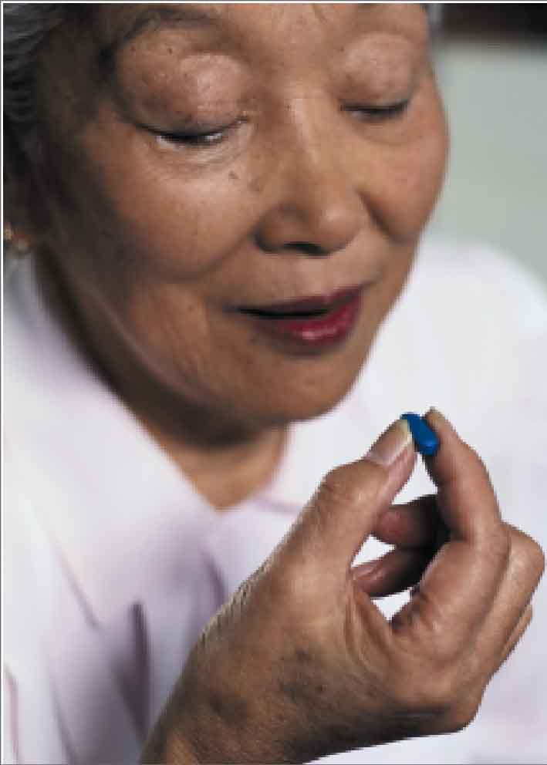
Launch Acceleration Services
Sales & marketing assistance
  Strategic and tactical market planning
  Dedicated/syndicated sales forces
  Sales force support services
Medical education services
Third party logistics services
RAPIDistribution - Launch to retail shelf in 48 hours
R_{x}ealTime market tracking
Formulary placement consulting
Alternate care site/clinic distribution
Notes:
Copyright 2002 Cardinal Health Inc All Rights Reserved
Cardinal Health Overview PResentation V3.9 April 2002
- 3rd party logistics - from CORD
- RAPIDistribution - from Cardinal Distribution
- RxealTime - from Arclight Systems
- Formulary Placement consulting - from Owen/Cardinal Provider Pharmacy Services
- Alternate Care Site/Clinic Distribution - from NSS

Slide 12


Medical Education
Medical Education Programs
Accredited & nonaccredited
Promotional Meetings
Logistics Management
Data collection & MIS
Patient education
Content development
Content delivery
Publication planning & support
Opinion leader management
Notes:
Copyright 2002 Cardinal Health Inc All Rights Reserved
Cardinal Health Overview PResentation V3.9 April 2002
We are committed to understanding the present and future needs of our pharmaceutical and biotechnology customers, and to meeting those needs through investments in facilities, existing and new technologies, and in the expertise of our employees.
From listening to our customers, we understood that the development “crunch” facing pharmaceutical companies today makes it even more critical that the drug discovery and development process be as efficient and effective as possible. While we had existing capabilities to offer our customers in the development services area, we felt that we needed to offer a greater breadth of services, and greater available resources, to help our customers shorten the development process.
We looked at building the capabilities internally, or buying a existing leading provider of those services - and decided to do both. To buy a “gold standard” provider of development services to pharmaceutical and biotechnology firms, and to construct a facility in the Northeast US to expand their capacity AND offer dedicated capacity for pilot scale oral manufacturing and packaging up to 1/10 scale.
Magellan is the leading US provider of contract drug development services.
Magellan is Cardinal Health’s sixteenth pharmaceutical technologies & services acquisition since 1996.

Slide 13
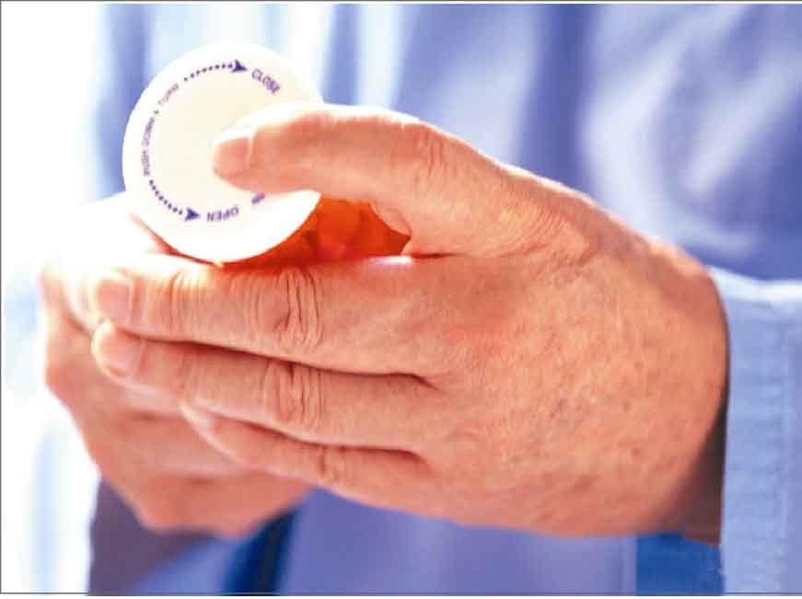
Life Cycle Extension
Enhancing market penetration
  Market share analysis and improvement
  Targeted promotions with measurable ROI
  Clinical/hospital usage/outcomes analysis
Extending product life
  Patented delivery systems and formulations to extend market exclusivity
  New dose forms to enhance and extend brand franchise
  Improved bioavailability, reduced side effects to generate new claims
Notes:
Copyright 2002 Cardinal Health Inc All Rights Reserved
Cardinal Health Overview PResentation V3.9 April 2002
The two categories above can broadly be described as:
- “Selling the existing drug better”, and
- “Improving the drug/dose form” to make a new and improved drug
Nearly 1 in 5 Pharma R&D dollars are spent on post-launch formulations, studies and indications - drug delivery and dose form choice can provide an expanded range of options - and we can offer you nearly every viable commercial option in that range.

Slide 14
The Benefits of Partnering with
Cardinal Health
Every day, we help our global pharmaceutical, biotechnology and consumer health customers by:
Bringing products to market faster
Bringing better products to market
Improving the profitability of product supply
Improving returns on marketing spend
Notes:
Copyright 2002 Cardinal Health Inc All Rights Reserved
Cardinal Health Overview PResentation V3.9 April 2002

Slide 15
Accelerating the Development Process
Multi-platform experience with discovery technologies and chemical synthesis
Innovative expertise in rapid formulations (and re-formulations) of drugs
Unmatched analytical science resources
Comprehensive global development programs
Comprehensive global clinical supply operations
Single-minded focus
Notes:
Copyright 2002 Cardinal Health Inc All Rights Reserved
Cardinal Health Overview PResentation V3.9 April 2002

Slide 16
Streamlining the Supply Chain
Practical and credible expertise in manufacturing and packaging nearly every dose form in nearly every route of administration
Proven benefits by integrating turnkey supply of:
  Dose form manufacturing
  Packaging
  Release testing
  Stability studies
  Logistics & specialty distribution synergies
Unmatched capacity, cGMP quality and global regulatory standards and experience
Measurable return - and fewer failure points
Notes:
Copyright 2002 Cardinal Health Inc All Rights Reserved
Cardinal Health Overview PResentation V3.9 April 2002

Slide 17
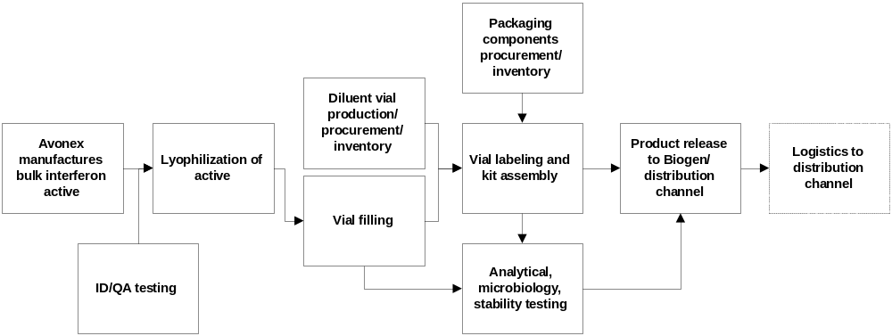
Streamlining the Supply Chain
A Case Study
Today’s supply chain
Notes:
Copyright 2002 Cardinal Health Inc All Rights Reserved
Cardinal Health Overview PResentation V3.9 April 2002

Slide 18
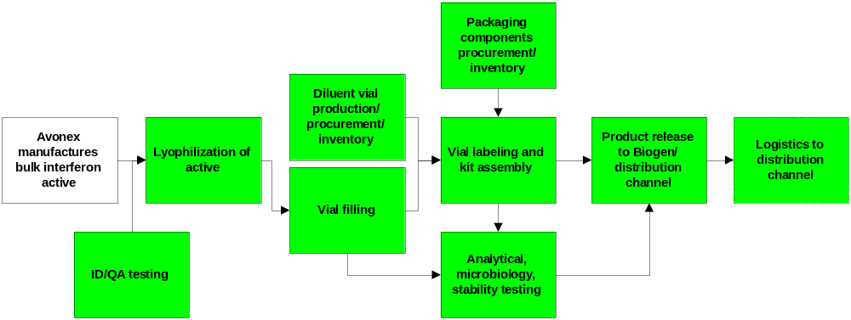
Streamlining the Supply Chain
A Case Study
Turnkey Supply Potential
Notes:
Copyright 2002 Cardinal Health Inc All Rights Reserved
Cardinal Health Overview PResentation V3.9 April 2002

Slide 19
Streamlining the Supply Chain
Improves Product Profitability
Turnkey supply allows for better inventory and production scheduling - reduce inefficiencies
Reduce work-in-process inventory funds
Reduced handling - re-deploy internal capacity to other priorities (like new launches!)
Continuous process improvement potential
Creative tax structures to maximize after-tax income
Our experience drives supply chain effectiveness - and profitability

Slide 20
Maximizing Your Product Potential
Depth of experience in key commercialization roles:
  Market strategy planning
  Medical education (development and execution)
  Sales forces (recruitment, management)
  Evaluation, analytics
Rapid formation of field sales forces
Rapid implementation of medical education strategies
Link with Cardinal Distribution’s unique launch acceleration programs
Creative use of cutting-edge ArcLight data for continuous (re) targeting
Notes:
Copyright 2002 Cardinal Health Inc All Rights Reserved
Cardinal Health Overview PResentation V3.9 April 2002

Slide 21
Cardinal Health Can Offer You
More than Ever Before
Speed at development and launch
Proven innovation to improve a drug’s value
Practical solutions to your challenges
Peace of mind
Please explore how we can partner together to maximize your success.

Slide 22
don.wetherhold@cardinal.com
Notes:
Copyright 2002 Cardinal Health Inc All Rights Reserved
Cardinal Health Overview PResentation V3.9 April 2002
NOTES
For questions on Cardinal Health, please email pts@cardinal.com, or visit www.cardinal.com/pts
Cardinal Health Employees: for questions on or suggestions regarding this presentation, please email Cornell Stamoran (cornell.stamoran@cardinal.com) or Pat McGee (patricia.mcgee@cardinal.com)
Version 3.9, 1 April 2002

